Slide 1
Data analysis and Visualization
Team 6

Slide 2
01
Our goal
02
Data statistics
Contents
03
Data processing
04
Result of simple regression model

Slide 3
01
Our Goal
Our novelty
YouTube View Count Prediction
Predicting YouTube Food Casting(먹방 유튜브) view counts by using thumbnail, name, number of subscribers and period
It may be useful for the people who want to measure the quality of their thumbnails
Thumbnail encoder
Thumbnail
Predictor
Name encoder
Name
Number of views
Number of Subscribers
Period
Figure 1. Overall structure of our proposal model
Notes:
Our goal is predicting you tube view coutns by using thumbnail, name, number of subscribers and period
Most important feature of our model -> image

Slide 4
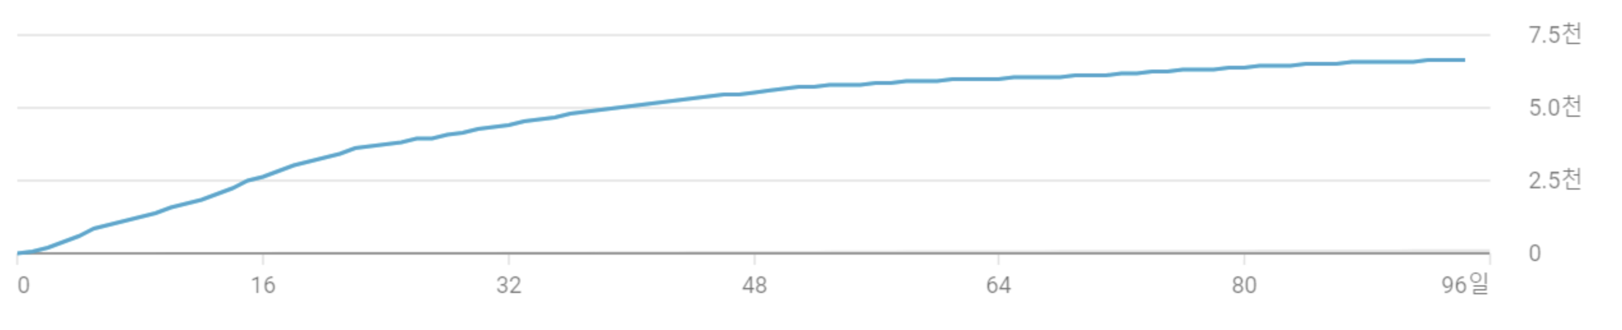
01
Our Goal
Expected result
Graph of time and view counts
Because view counts depend on time period
variable
function(thumbnail, name, number of subscribers, uploaded period) = view counts
Notes:
Output: graph

Slide 5


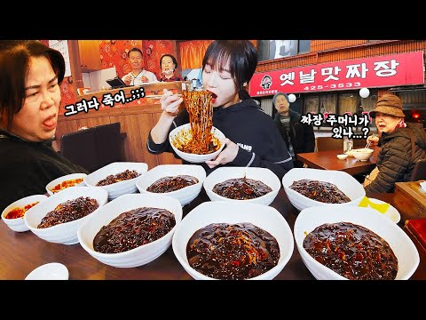
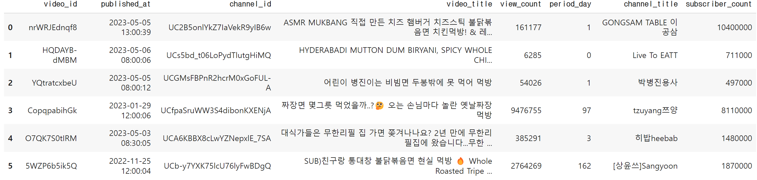
02
Data Statistics
How to collect Dataset
Crawling from YouTube
Extract video title, uploaded period, number of subscribers, thumbnail and others

Slide 6
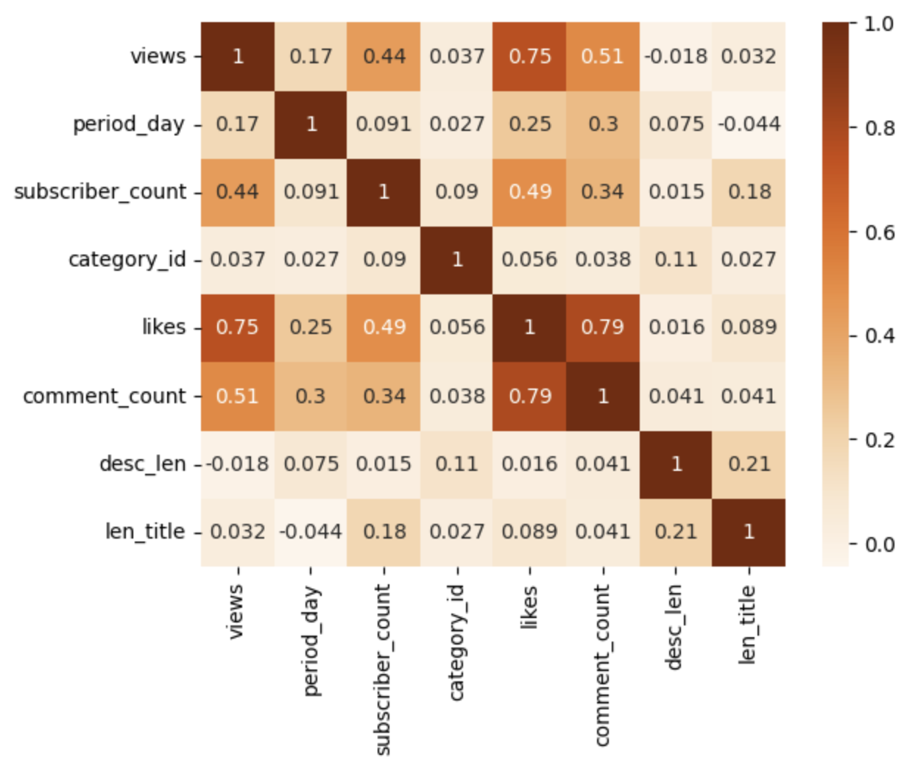
02
Data Statistics
Statistical view of dataset
Uploaded period and number of subscribers have high correlation with view counts
Number of comments and likes are not going to be used.
We cannot know the number of likes and comments in advance!

Slide 7
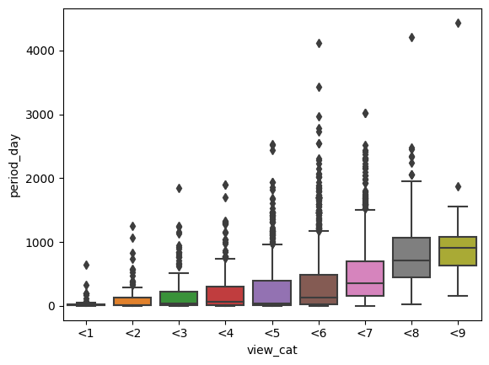
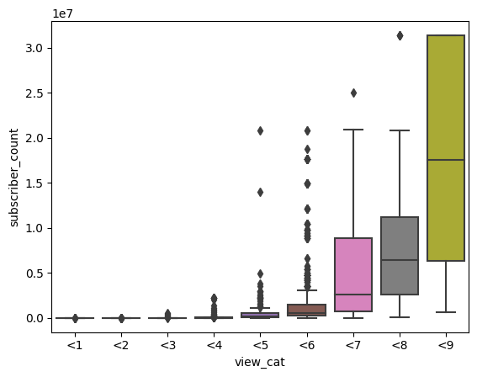
02
Data Statistics
Visualization of uploaded period and number of subscribers
Can observe that view counts has high relationship with uploaded period and number of subscribers.
The reason of why we use those two values for our model training
Uploaded period
Number of subscribers
log10(view counts)
log10(view counts)

Slide 8
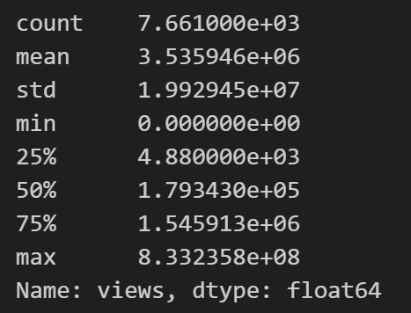
03
Data processing
Problem of using raw view counts
There is too big scope to predict
It may drop the performance of model
Statistical information of ‘view counts’
Huge difference between min and max value of view counts
Notes:
- few-shot segmenta

Slide 9
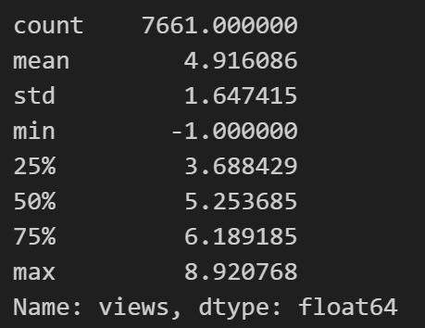
03
Data processing
How to solve the large scope problem?
Use log value of view counts
Reasonable because it can penalize large view counts
(additional of view counts has different meaning depend on the size of views)
Small view counts VS Large view counts
log( view counts )
Small view counts( 10 ) | Large view counts( 1000 )
10 + 1 → 10% increase | 1000 + 1 → 0.1% increase
Meaningful | Not meaningful
Much smaller scope between min and max value of view counts
Notes:
- few-shot segmenta

Slide 10
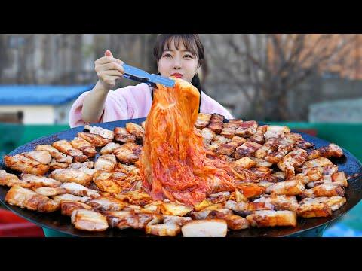
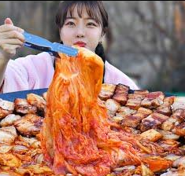

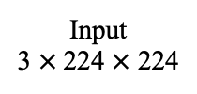

03
Data processing
Using Encoder – Thumbnail Encoder
Use ResNet18 for quick learning in colab.
If the pre-trained model's performance is not good, there is a plan to make an encoder specialized for thumbnails by additional training.
Transform
: RandomCrop
Original
3 $×$ 360 $×$ 480
Input
3 $×$224 $×$ 224
ResNet18
Output
512 $×$7 $×$ 7 feature map
Notes:
- few-shot segmenta

Slide 11
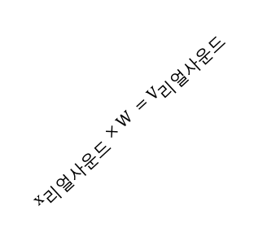

03
Data processing
Using Encoder – Title Encoder
Use Word2Vec.
Output is embedding vector.
1
Use regular expressions to remove letters other than Korean.
0
꼴뚜기
(one-hot vector)
$$x_{꼴두기} × W =V_{골뚜기}$$
0
…
0
0.1
꼴뚜기 듬뿍 넣은 꼴뚜기라면 먹방~!! 리얼사운드 ASMR Mukbang(Eating Show)
꼴뚜기 듬뿍 넣은 꼴뚜기라면 먹방 리얼사운드
0.4
…
Output
0.2
…
0.5
1
M
(hidden layer size)
Original
Input
(Only Korean)
$$x_{리얼사운드} × W =V_{리얼사운드}$$
리얼사운드
(one-hot vector)
0
0
…
0
V
(vocabulary size)
Notes:
- few-shot segmenta

Slide 12
04
Result of simple regression model
Baseline Model : Linear Regression (scikit-learn)
Input : Thumbnail image(Greyscale + flatten), Number of subscribers, Period
Output : Number of views
Title encoder(for processing sequence of words) is not determined yet
→ Future work(Next week we will train baseline with 100% features)
Greyscale
+ Flatten
Experiment Result
Train : Test = 1042 : 116
MSE (Train) : 1.19e-22
MSE (Test) : 0.61
Thumbnail
(120,90,3)
Linear
Regression
Number of views
Number of Subscribers
Period
Figure 2. Baseline model
Notes:
- few-shot segmenta

